Slide 1
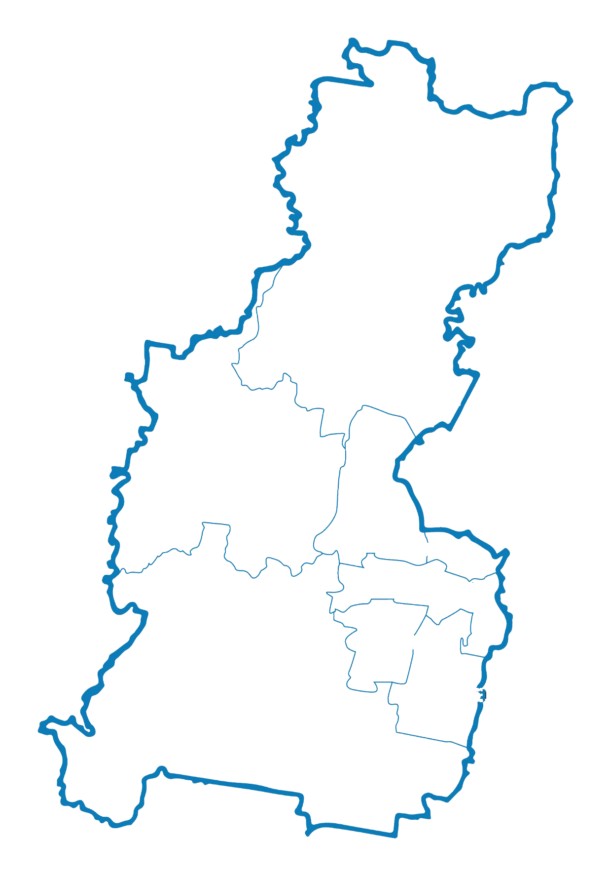









Toward a digitally inclusive Western Parkland City
A guide for councils
HAWKESBURY
BLUE MOUNTAINS
PENRITH
FAIRFIELD
LIVERPOOL
CAMDEN
WOLLONDILLY
CAMPBELLTOWN

Slide 2
What is digital inclusion?
Digital inclusion means that everyone can access, afford and have the ability to engage with digital technologies to participate in the digital world.
Local councils play an important role in ensuring everyone in the community can confidently use digital technologies.
Councils in Western Parkland City are already implementing many initiatives toward a more digitally inclusive future for their community.

Slide 3
Why is digital inclusion important for councils?
Access to the internet and digital technologies is no longer a luxury but a fundamental necessity to participate in life.
Councils are shifting more core services to online, including community engagement and planning portals. Digital inclusion will:
Ensure all community members have equal opportunity to access, participate and interact with their local council
Improve efficiency for council operations
Provide economic benefits to councils
Ensure no one is left behind

Slide 4
Digital challenges in the Western Parkland City
There is lower use of computers and lower access to digital technology
Less people use online resources and services
Cutting back on essential household costs to afford an internet connection is common
Many communities experience mobile blackspots and interruptions to internet use
Areas with an older population experience lower ability to use digital technology
30% of Western Parkland City residents are digitally excluded
Source: Uncovering the Digital Divide in the Western Parkland City: Findings report for Western Parkland City Digital Equity and Inclusion Program

Slide 5
Benefits of digital inclusion for the community
People can communicate and connect with others
Loneliness among older people decreases
People can get the information they need to be safe in emergencies
Online government services can be easily accessed
There are opportunities for education and skill building
People can apply for and change jobs

Slide 6
About the guide
A digital inclusion guide has been developed to further assist councils in the Western Parkland City to improve digital inclusion for their community. The guide includes:
Guidance for how councils can support digital inclusion through their strategic and operational planning processes
Overview of digital challenges in the Western Parkland City and the case for change
Practical ideas, possible opportunities for consideration and case studies

Slide 7
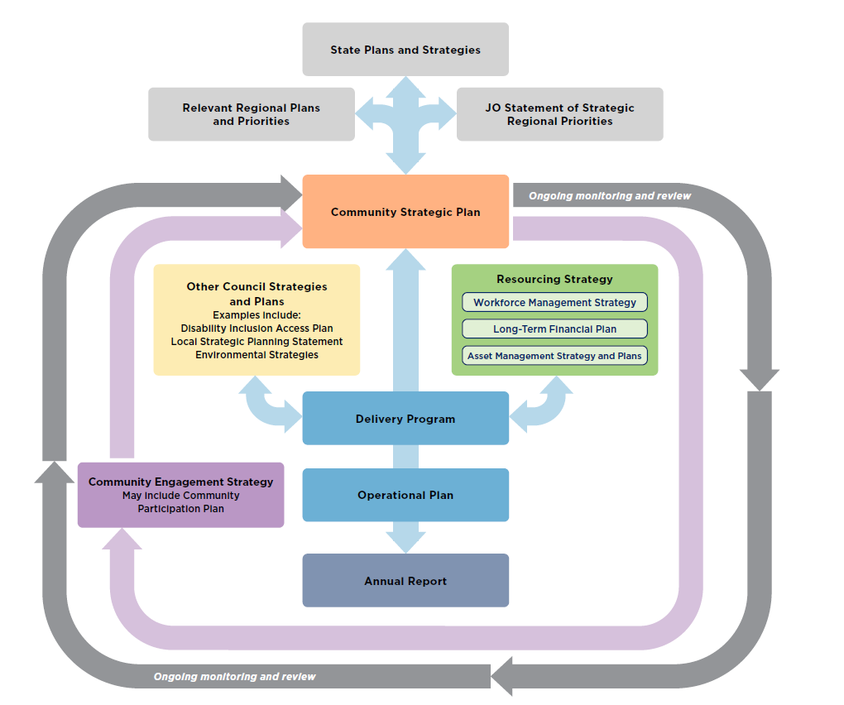
How to use the guide through the IP&R framework
Seek feedback from your community about their experience with digital exclusion
Include digital inclusion as a principle or goal in your CSP
Consider alternative funding and grant programs
Have a dedicated digital equity and inclusion officer
Provide free Wi-Fi and computers in libraries
Create a digital equity and inclusion strategy
Targeted toward all general staff (not executive level)
Notes:
Main slide option 1: Targeted toward staff (not executive level)

Slide 8
Digital inclusion can be embedded through the IP&R framework
Targeted toward executive level
Notes:
Main slide option 2: Targeted toward the executive level

Slide 9
Making digital inclusion happen
Long-term financial planning
Workforce planning
Asset management planning
Targeted toward executive level and corporate planners
Alternative funding
Grant programs
Volunteer and community-based programs
Development contributions
Innovative service-delivery models
Digital equity and inclusion officer
Digital equity and inclusion working group
Digital equity and inclusion champions
Digital literacy training to all staff
Wi-Fi and computers in libraries and public areas
Access to devices and software
Private meeting spaces
Notes:
This slide is targeted toward the executive level and corporate planners

Slide 10
How to engage with your community about digital inclusion
To raise digital inclusion when engaging with your community, you can:
Share data about digital inclusion in your LGA
Promote the benefits of digital inclusion
Seek feedback from your community about their experience with digital exclusion (including in relation to council communication and services)
Involve the community in developing objectives and strategies to make your LGA more digitally inclusive
Targeted toward community engagement teams
Notes:
This slide is targeted toward community engagement teams

Slide 11
How to embed digital inclusion in your CSP
You could include a broad overarching principle or goal, such as ‘digital equity and inclusion’ in your CSP.
This will ensure that more detailed strategies and actions are addressed through your Operational Plan and Delivery Program.
It will also support ongoing data collection to understand the status of digital equity and inclusion in your community over time.
Targeted toward corporate planners
Notes:
This slide is targeted toward corporate planners

Slide 12
Opportunities in other strategies and plans
Digital inclusion considerations can also be reflected in and addressed through your other supporting strategies, plans and policies:
local strategic planning statements
disability inclusion action plans
smart city or innovation strategies
social plans
health and wellbeing strategies
community safety and crime prevention strategies
ageing strategies
community facilities strategies
economic development strategies
public open space strategies
Targeted toward corporate planners
Notes:
This slide is targeted toward corporate planners

Slide 13
Monitoring, reporting and evaluation
Monitoring, reporting and evaluation is important to measure the effectiveness of your digital inclusion initiatives.
Targeted toward all general staff (not executive level)
Suggested sources include:
community surveys and consultations
attendance at training sessions, programs or events
ABS Census data
council engagement website statistics
council library website statistics
customer satisfaction surveys
library satisfaction surveys

Slide 14
Resources
NSW Digital Connectivity Index
SmartNSW Case Study Library
SmartNSW Playbook
Targeted toward all general staff (not executive level)
Uncovering the Digital Divide in the Western Parkland City: Findings report for Western Parkland City Digital Equity and Inclusion Program
The Parks services and learning opportunities
The Parks Online Service Hub

Slide 15
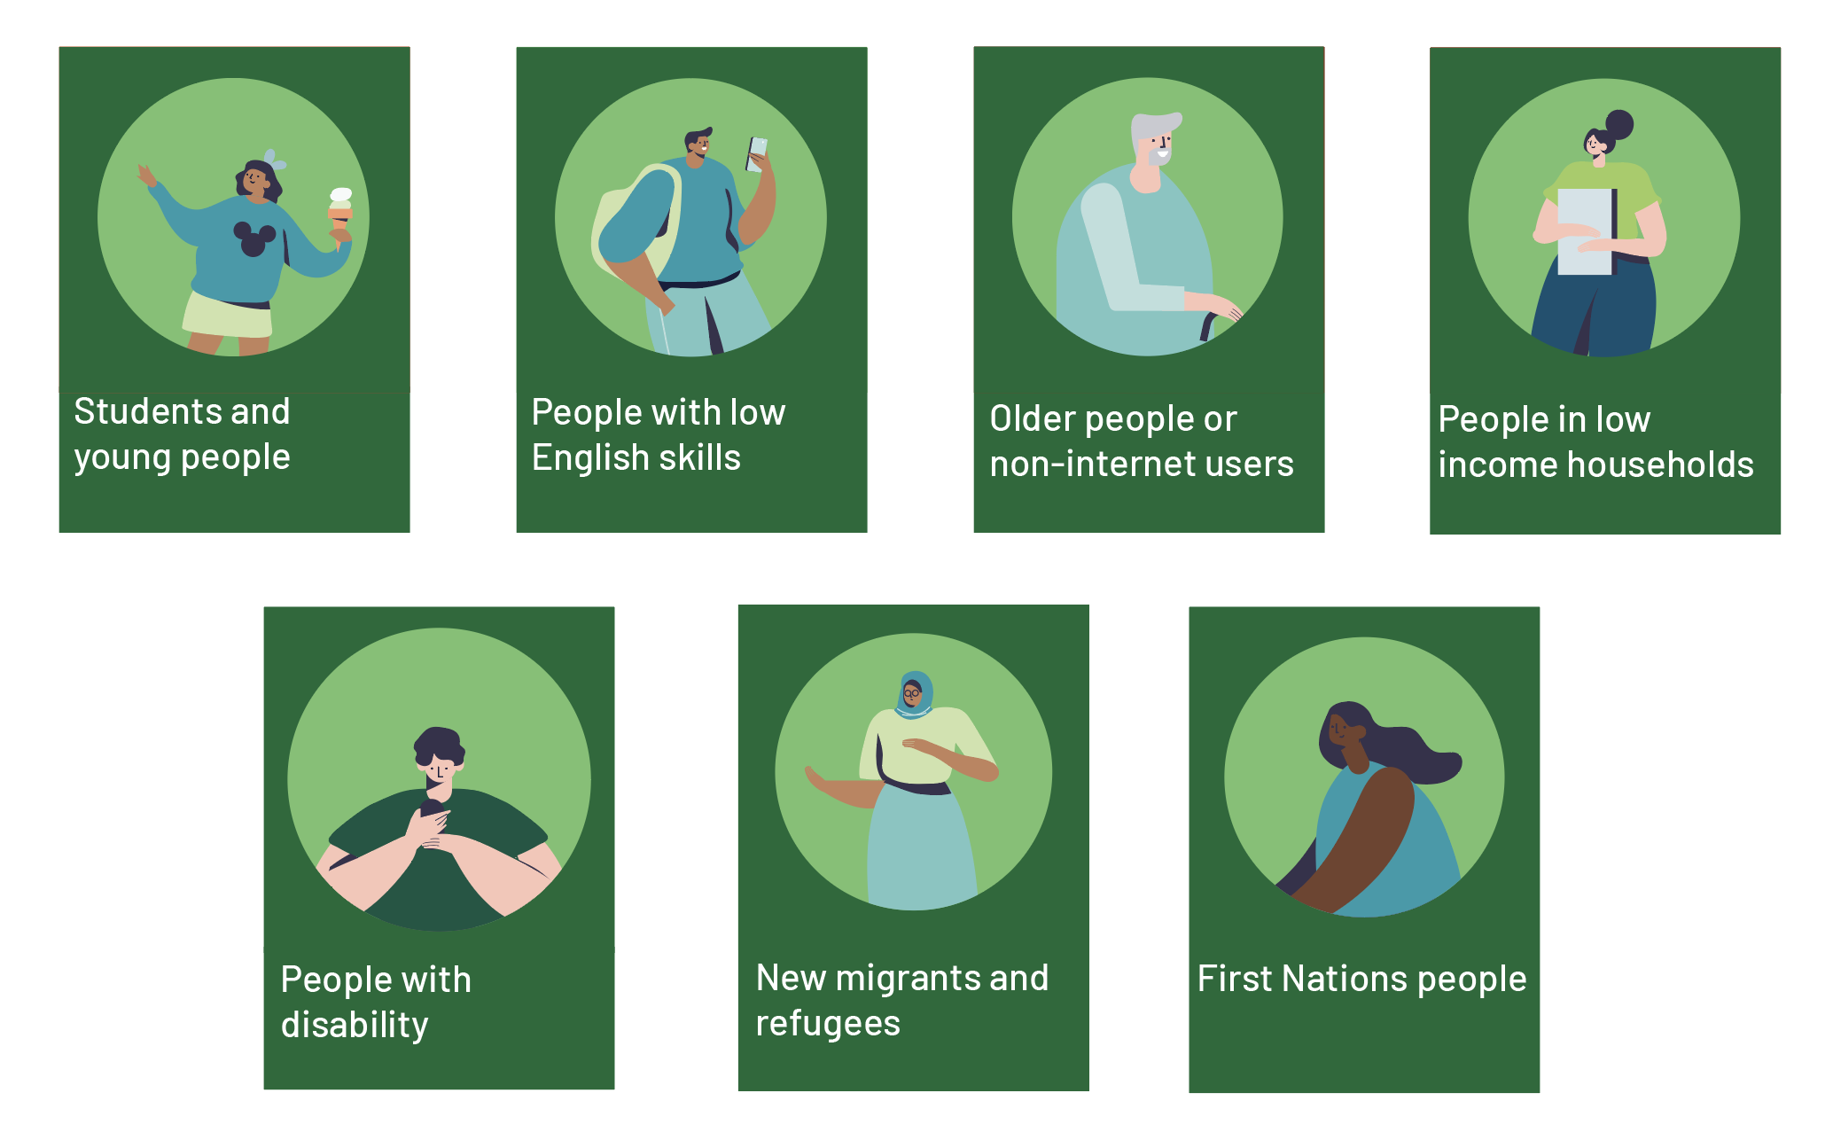
Tools – Targeted strategies for vulnerable cohorts
Targeted toward all general staff (not executive level)

Slide 16

Tools - Good to best practice activities
Example opportunities you can consider in your Delivery Program and Operational Plan to improve digital inclusion, from good to best practice.
Targeted toward all general staff (not executive level)
Good
Better
Best

Slide 17
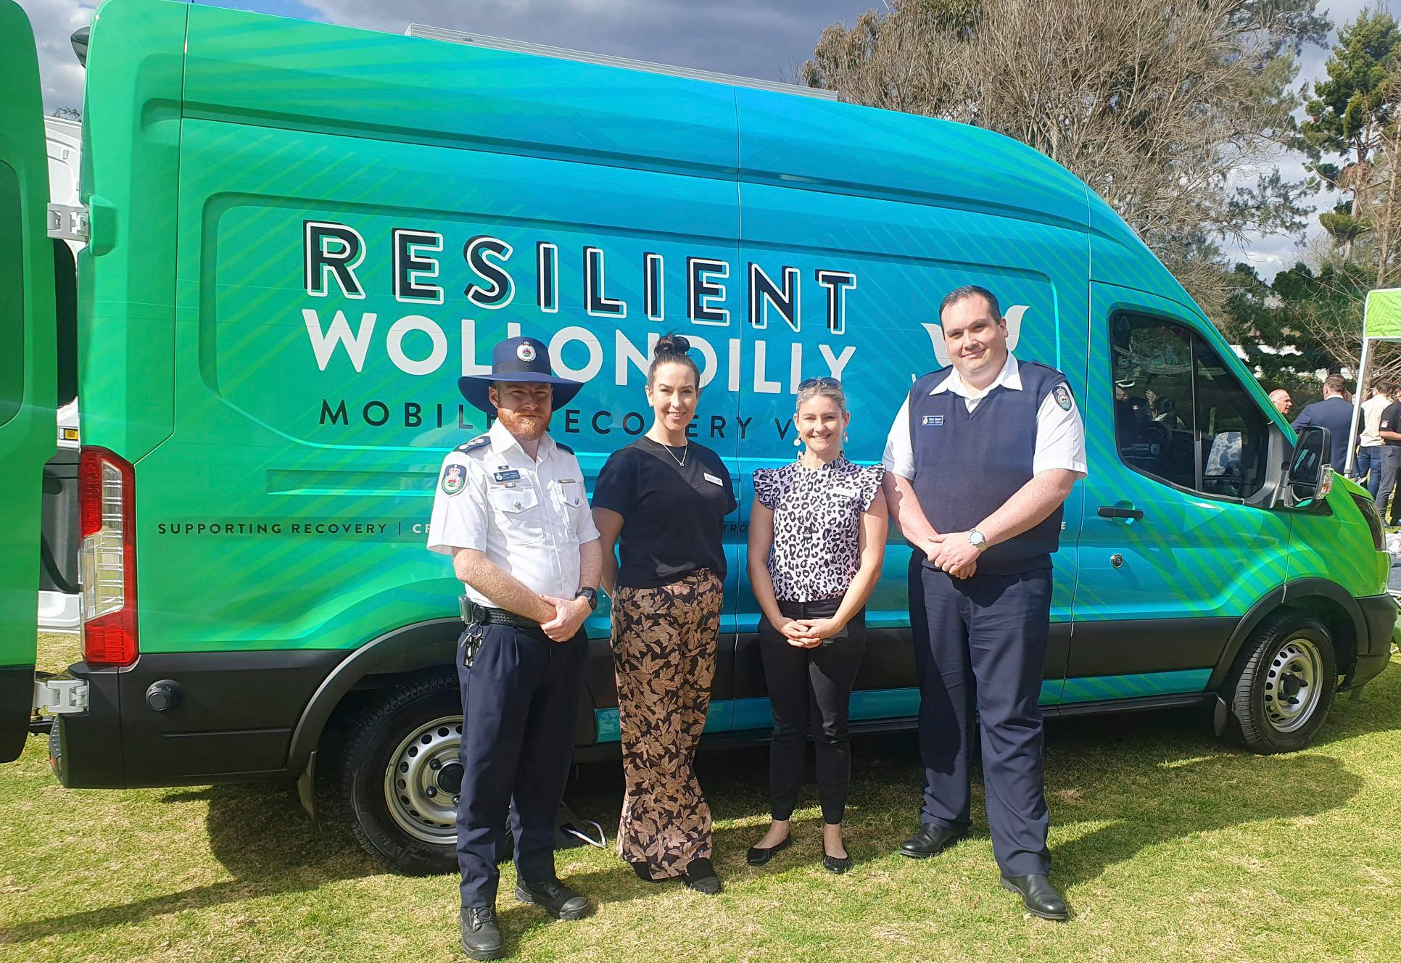
Case study: Resilient Wollondilly Van
Wollondilly Shire Council created a mobile van fitted out with amenities, including Wi-Fi and tablets. Council use this van to conduct community outreach and education in areas with limited or no connectivity.
Image source: Wollondilly Shire Council

Slide 18

Case study: Click and Connect
Penrith City Council partnered with the Digital Literacy Foundation to deliver an iPad loan program where community members can get free access to an iPad and data to use at home for up to six months.
Image source: Be Connected Network

Slide 19
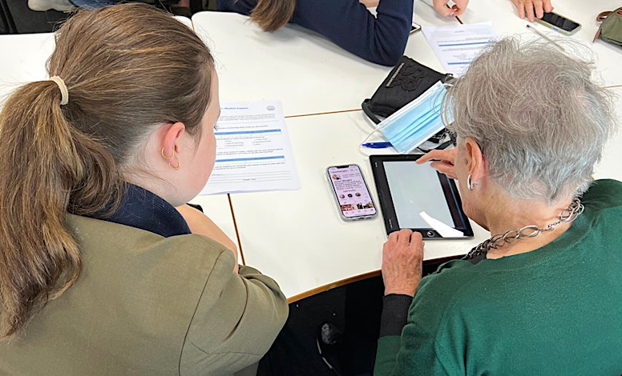
Case study: Tech at Ascham
Woollahra Municipal Council
organised a free, weekly digital skills program for people aged 55+, in collaboration with Ascham School. Tuition is provided on a one-on-one basis by high school students under teacher supervision.
Image source: Woollahra Municipal Council

Slide 20


